Slide 1

What is
investment?
Notes:
[Sources]
- C:/Users/oehle/Documents/oehler-huang-platform/apps/library/investment-analysis/handouts/Investment Version 24.docx
- https://www.apec2026.cn/node_196.html
[/Sources]

Slide 2
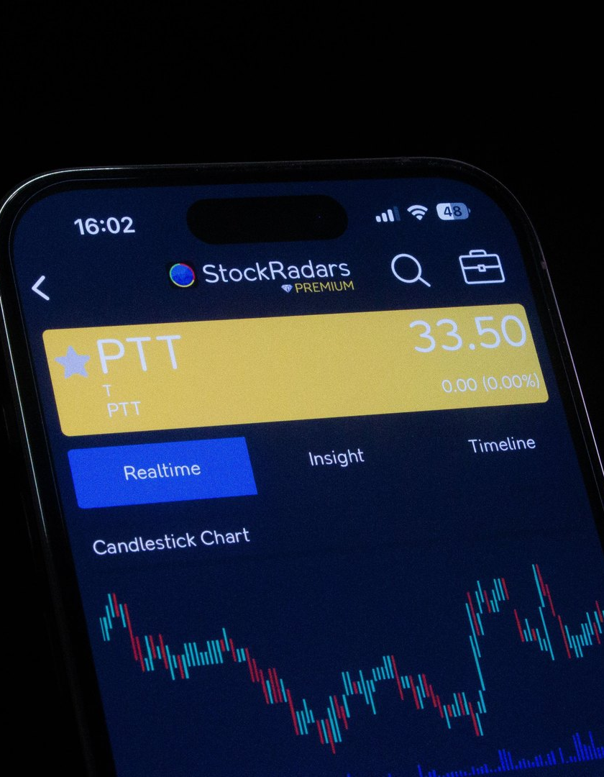
A friend says a share price will rise tomorrow.
Would you borrow ¥1,000 to buy it?
What would you need to know first?
朋友说某只股票明天会涨。你会借¥1,000买入吗？
你首先需要知道什么？
Notes:
First judgement: students choose yes or no, then name the information they would need. Do not introduce the labels investment, speculation or saving yet. Return to this decision on slide 24.
[Sources]
- C:/Users/oehle/Documents/igcse-term-outlines/outputs/investment-course-one-semester/Investment and Financial Decision-Making - 2026-27 Semester 1 Bilingual Department Leadership Learning Summary.pdf
- C:/Users/oehle/Documents/oehler-huang-platform/apps/library/investment-analysis/handouts/Investment Version 24.docx
- https://www.pexels.com/photo/smartphone-displaying-stock-trading-app-interface-28682345/
[/Sources]

Slide 3
TWO-LESSON DESTINATION
What you will be able to do
1
2
3
4
Distinguish investment, speculation and saving
Calculate simple investment returns
Give relevant examples
Justify each classification
Course map | Investment lesson 1
02
Notes:
Use this as the two-lesson learning contract. The first two outcomes dominate Lesson 1; the last two are revisited and extended in Lesson 2.
[Sources]
- C:/Users/oehle/Documents/igcse-term-outlines/outputs/investment-course-one-semester/Investment and Financial Decision-Making - 2026-27 Semester 1 Bilingual Department Leadership Learning Summary.pdf
- C:/Users/oehle/Documents/oehler-huang-platform/apps/library/investment-analysis/handouts/Investment Version 24.docx
[/Sources]

Slide 4

Is this investment?
Notes:
[Sources]
- https://uk.finance.yahoo.com/news/investing-money-savings-risks-finances-050038406.html
[/Sources]

Slide 5
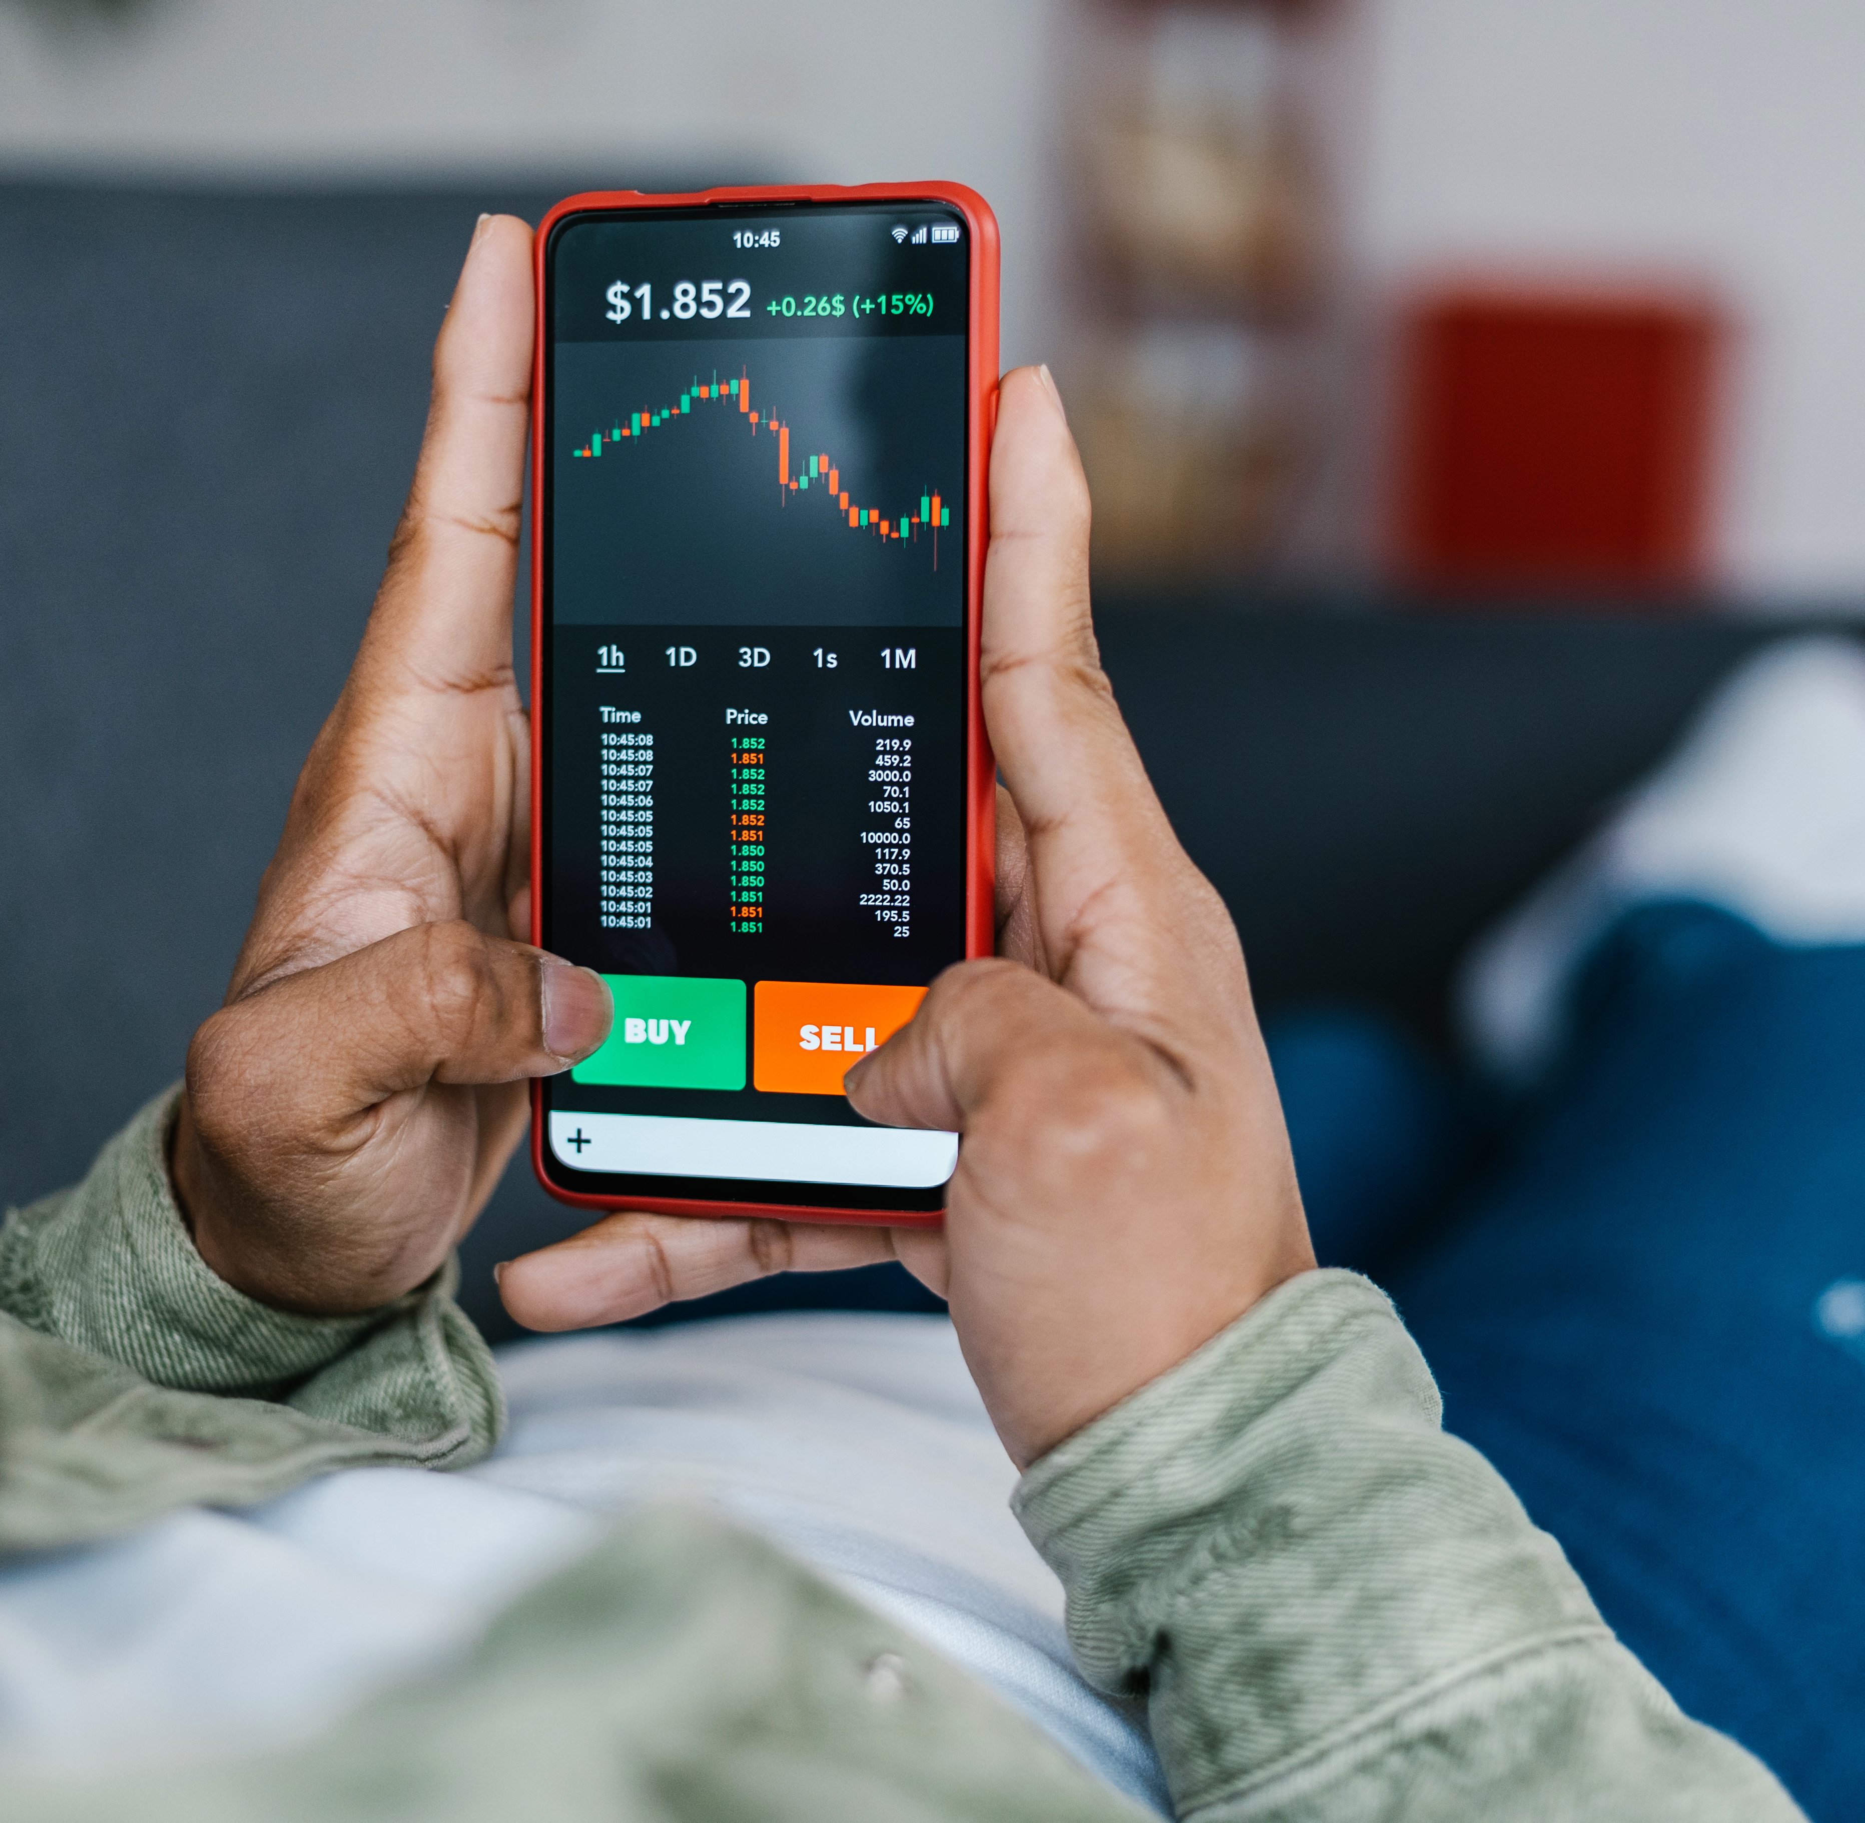
Speculation (投机)
Trading mainly to profit from a predicted price change (预测的价格变动).
Income or underlying value (基础价值) is not the main basis.
Examples:
• shares bought after a rumour, gold bought for rapid resale
• currency traded after an exchange-rate prediction.
Notes:
[Sources]
- C:/Users/oehle/Documents/oehler-huang-platform/apps/library/investment-analysis/handouts/Investment Version 24.docx
- https://www.kiplinger.com/investing/ways-your-phone-can-help-you-weather-market-volatility
[/Sources]

Slide 6
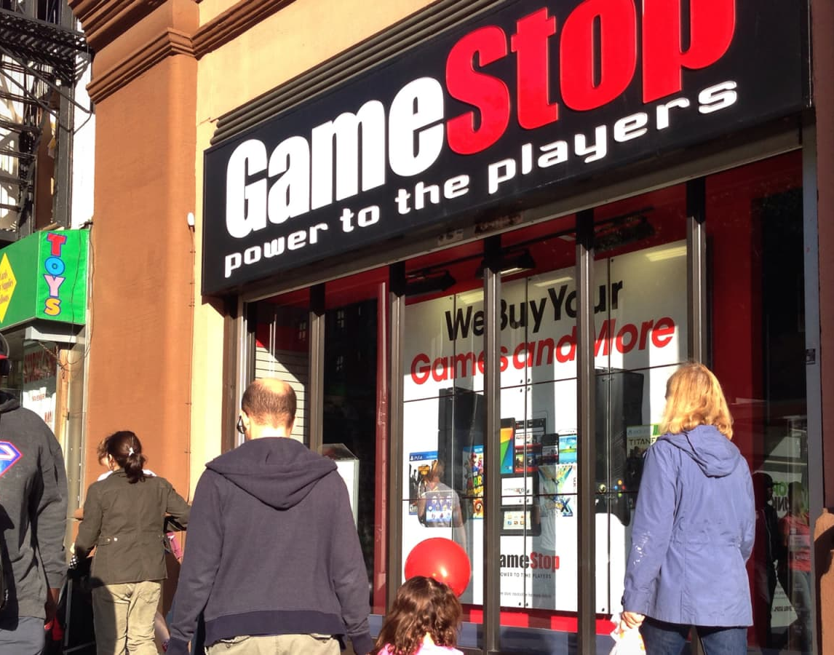
A rapid price rise can reverse quickly
GameStop, January 2021
• More than 1,600% rise from the 11 January close to the 27 January close
• USD 483 intraday high on 28 January
• More than 86% fall from that high by the end of the first week of February
Notes:
Figures are pre-2022 stock-split prices, as reported by the SEC.
[Sources]
- https://www.sec.gov/files/staff-report-equity-options-market-struction-conditions-early-2021.pdf
- https://www.cnbc.com/2019/03/27/gamestop-doubling-down-on-its-investment-in-surging-esports-industry.html
[/Sources]

Slide 7
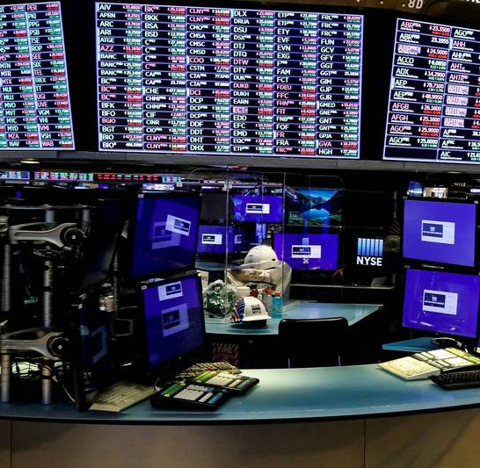
Why may speculation be a bad idea?
One reason is the cost of frequent trading.
A study of 66,465 households found annual returns of:
Most-active households: 11.4%
Market: 17.9%
Trading costs reduced the net return of the most-active group.
Notes:
Barber and Odean sample period: 1991-1996. Historical evidence does not predict every trader's result.
[Sources]
- https://faculty.haas.berkeley.edu/odean/papers/returns/individual_investor_performance_final.pdf
- https://ec.ltn.com.tw/article/breakingnews/3466782
[/Sources]

Slide 8
Quick check: speculation (投机)
True or false?
A short holding period always makes a decision speculation.
Explain using the expected payoff basis (预期回报依据).
Notes:
Answer: False. A short holding period alone does not decide the category. The decisive clue is the expected payoff basis: speculation relies mainly on a predicted price change rather than expected income or evidence about underlying value.
[Sources]
- C:/Users/oehle/Documents/oehler-huang-platform/apps/library/investment-analysis/handouts/Investment Version 24.docx
- C:/Users/oehle/Documents/igcse-term-outlines/outputs/investment-course-one-semester/Investment and Financial Decision-Making - 2026-27 Semester 1 Bilingual Department Leadership Learning Summary.pdf
[/Sources]

Slide 9
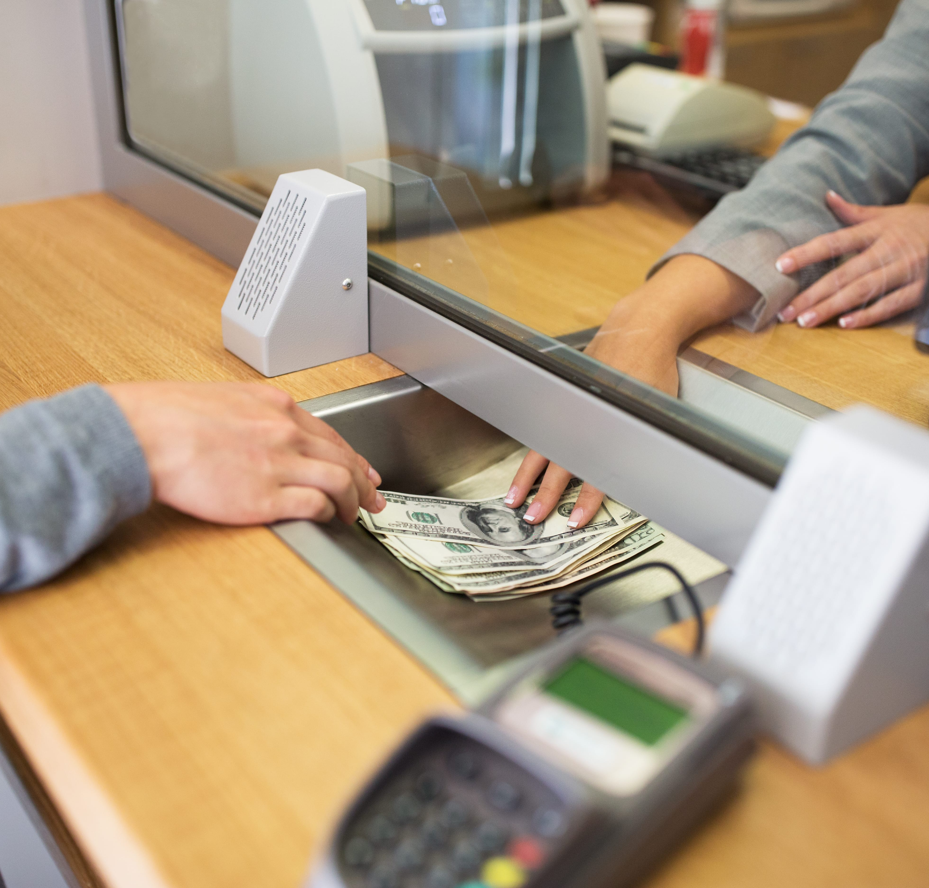
Saving can earn interest
China, end-2025
CNY 167.0 trillion
domestic household deposits
9.7% increase from end-2024
Saving can serve a near-term need even when it earns some interest.
Notes:
[Sources]
- https://www.stats.gov.cn/english/PressRelease/202602/t20260228_1962661.html
- https://www.cca.org.mx/CCA_cursos/finanzas_personales/html/modulo3/modulo3-13.html
[/Sources]

Slide 10

Is this investment?
Notes:
[Sources]
- https://www.cnbc.com/2019/12/18/how-to-build-an-emergency-savings-fund.html
[/Sources]

Slide 11

Saving
Saving is current income not spent now.
Emphasis:
• capital preservation (保本)
• liquidity (流动性)
Examples:
• emergency fund (应急资金)
• examination fees held for a known date
• short-term cash buffer (现金缓冲)
Notes:
[Sources]
- C:/Users/oehle/Documents/oehler-huang-platform/apps/library/investment-analysis/handouts/Investment Version 24.docx
- https://www.lepoint.fr/eureka/pourquoi-les-tirelires-ont-elles-la-forme-d-un-cochon-27-09-2024-2571328_4706.php
[/Sources]

Slide 12
Quick check: saving (储蓄)
An account pays interest.
Does that automatically make the decision a financial investment?
Explain using purpose, capital preservation (保本) and liquidity (流动性).
Notes:
Answer: No. Earning interest does not automatically change saving into financial investment. If the main purpose is a near-term need, capital preservation and liquidity, the decision can remain saving.
[Sources]
- C:/Users/oehle/Documents/oehler-huang-platform/apps/library/investment-analysis/handouts/Investment Version 24.docx
- C:/Users/oehle/Documents/igcse-term-outlines/outputs/investment-course-one-semester/Investment and Financial Decision-Making - 2026-27 Semester 1 Bilingual Department Leadership Learning Summary.pdf
[/Sources]

Slide 13
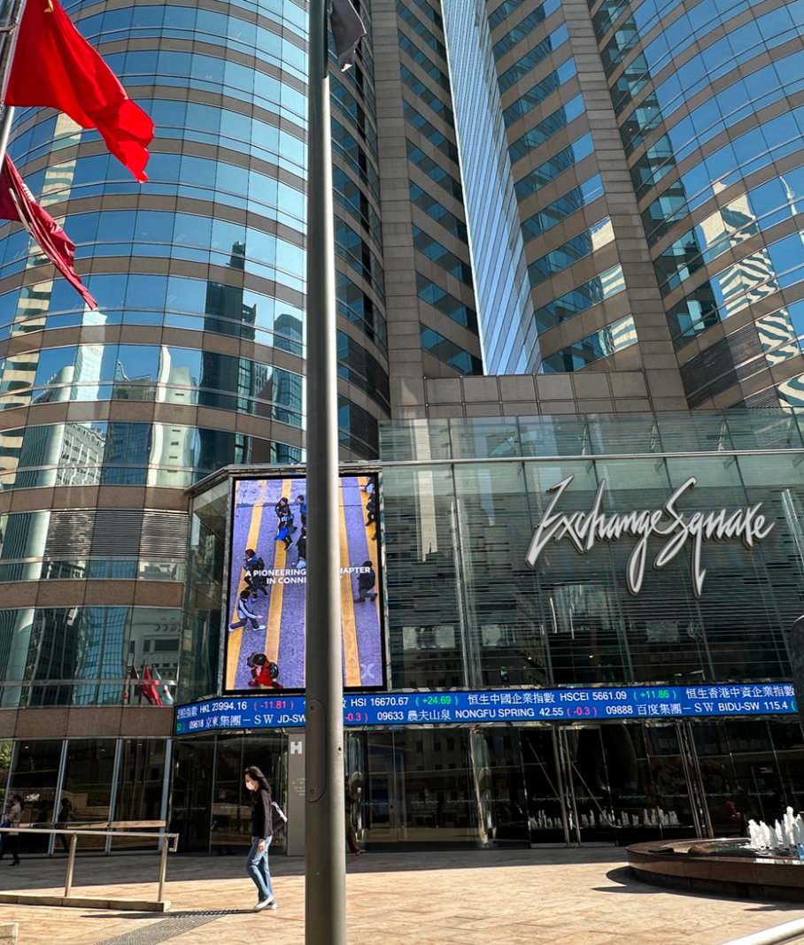
Financial investment (金融投资)
Putting money into an asset (资产) to seek future total return (总回报)
Total return = income + change in market value
Risk: possible loss (可能亏损)
Examples: stocks, index funds, bonds and property
Notes:
[Sources]
- C:/Users/oehle/Documents/oehler-huang-platform/apps/library/investment-analysis/handouts/Investment Version 24.docx
- https://www.chinadailyhk.com/hk/article/605229
[/Sources]

Slide 14
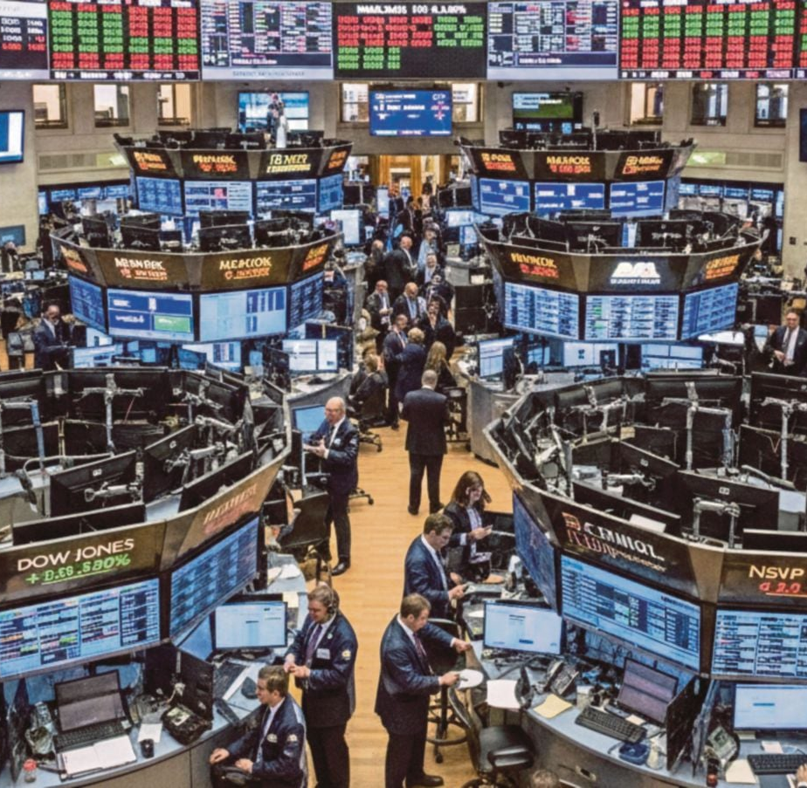
Example: Stocks
S&P 500, calendar 2025
Price return: 16.39%
Total return with dividends: 17.88%
USD 10,000 would become:
USD 11,639 without dividends
USD 11,788 with dividends
The difference came from dividends.
Notes:
Data as of 31 December 2025. The USD illustration excludes fees, taxes and currency effects.
[Sources]
- https://www.spglobal.com/spdji/en/commentary/article/us-equities-market-attributes/
- https://www.nst.com.my/business/corporate/2026/02/1371314/stocks-fluctuate-after-wall-street-ai-fuelled-sell
[/Sources]

Slide 15
Choose: Investment (投资), speculation (投机) or saving (储蓄)?
1. The main basis is expected income and/or evidence about underlying value; possible loss is accepted.
2. The main reason is a predicted price change; income or underlying value is not the main basis.
3. Money is kept mainly for a future need, safety and ready access.
4. Amina studies profits, cash flow and debt before buying a diversified share portfolio. She expects dividends and long-term price growth.
5. Bao borrows after an online rumour predicts a price rise next week. He will sell after an announcement.
Notes:
[Sources]
- C:/Users/oehle/Documents/oehler-huang-platform/apps/library/investment-analysis/handouts/Investment Version 24.docx
[/Sources]

Slide 16
Choose: Investment (投资), speculation (投机) or saving (储蓄)?
6. Chloe estimates rent, maintenance and vacancy costs. She buys a flat mainly for net rental income.
7. Daniel needs examination-fee money in eight months, so he uses an easy-access account for safety and liquidity.
8. Eva invests for university in ten years using a diversified fund. She reviewed fees and risks and accepts a possible fall in market value.
9. Farah keeps an emergency fund in an easy-access account. Quick withdrawal matters more than return.
10. George buys a bond fund for retirement after checking interest income, credit risk, interest-rate risk and fees.
Notes:
[Sources]
- C:/Users/oehle/Documents/oehler-huang-platform/apps/library/investment-analysis/handouts/Investment Version 24.docx
[/Sources]

Slide 17
Choose: Investment (投资), speculation (投机) or saving (储蓄)?
11. Hadi buys Bitcoin after an influencer predicts a weekend price jump. He will sell immediately if it happens.
12. Iris buys foreign currency before a central-bank announcement. Her expected gain depends on a price prediction.
13. Jun needs tuition money in three months, so he uses an easy-access account for safety and liquidity.
Notes:
[Sources]
- C:/Users/oehle/Documents/oehler-huang-platform/apps/library/investment-analysis/handouts/Investment Version 24.docx
[/Sources]

Slide 18
MCQ 1
What is the strongest evidence that a decision is a financial investment (金融投资)?
A. The asset has risen in price before.
B. The main basis is expected income and/or evidence about underlying value, while possible loss is accepted.
C. Money can be withdrawn immediately with no possible loss.
D. The buyer plans to sell after an unverified rumour.
Notes:
Answer: B. Decisive clue: the expected payoff is supported by income and/or evidence about underlying value, while possible loss is accepted.
[Sources]
- C:/Users/oehle/Documents/oehler-huang-platform/apps/library/investment-analysis/handouts/Investment Version 24.docx
[/Sources]

Slide 19
MCQ 2
Which decision is saving (储蓄) rather than financial investment (金融投资)?
A. Keeping school-trip money in an easy-access account.
B. Buying a diversified fund for long-term growth after reviewing its fees and risks.
C. Buying shares for dividends and long-term value after analysing profits, debt and cash flow.
D. Buying property mainly for expected net rental income.
Notes:
Answer: A. Decisive clue: the money is for a known near-term need, so liquidity and capital preservation matter most.
[Sources]
- C:/Users/oehle/Documents/oehler-huang-platform/apps/library/investment-analysis/handouts/Investment Version 24.docx
[/Sources]

Slide 20
MCQ 3
Which evidence most clearly indicates speculation (投机)?
A. Expected bond interest after analysing credit risk.
B. Expected net rental income after estimating vacancy and maintenance.
C. Borrowing after a rumour of a next-week price jump and planning a quick sale.
D. Accepting that a diversified fund held long term can lose value.
Notes:
Answer: C. Decisive clue: the decision relies on a rumour and a predicted short-term price rise, with borrowing increasing possible loss.
[Sources]
- C:/Users/oehle/Documents/oehler-huang-platform/apps/library/investment-analysis/handouts/Investment Version 24.docx
[/Sources]

Slide 21
MCQ 4
Which statement about saving (储蓄) is correct?
A. Earning interest automatically changes saving into financial investment (金融投资).
B. Saving cannot lose purchasing power (购买力).
C. Capital preservation (保本) and liquidity (流动性) can matter more than a high return.
D. Saving always means holding cash at home.
Notes:
Answer: C. Decisive clue: saving can prioritise capital preservation and liquidity even when it earns interest.
[Sources]
- C:/Users/oehle/Documents/oehler-huang-platform/apps/library/investment-analysis/handouts/Investment Version 24.docx
[/Sources]

Slide 22
MCQ 5
Two people buy the same asset (资产). Why might one be investing (投资) and the other speculating (投机)?
A. The asset name decides the category.
B. The person who pays the higher price is the speculator (投机者).
C. One bases expected return on income and/or evidence about long-term value; the other mainly on a price prediction (价格预测).
D. The person planning to sell sooner is always the speculator (投机者).
Notes:
Answer: C. Decisive clue: classify the decision by its expected payoff basis and evidence, not by the asset name.
[Sources]
- C:/Users/oehle/Documents/oehler-huang-platform/apps/library/investment-analysis/handouts/Investment Version 24.docx
- C:/Users/oehle/Documents/igcse-term-outlines/outputs/investment-course-one-semester/Investment and Financial Decision-Making - 2026-27 Semester 1 Bilingual Department Leadership Learning Summary.pdf
[/Sources]

Slide 23

Short answer question 1: save first or invest now?
Mina receives ¥500 and has no money set aside for emergencies. Should she save some before investing? Explain.
Use at least two terms:
emergency fund (应急资金)
liquidity (流动性)
essential spending (必要支出)
possible loss (可能亏损)
Notes:
[Sources]
- C:/Users/oehle/Documents/oehler-huang-platform/apps/library/investment-analysis/handouts/Investment Version 24.docx
- https://www.hanseaticbank.de/klarmacher/vorsorgen/die-betriebliche-altersvorsorge-kuendigen-geht-das-ueberhaupt
[/Sources]

Slide 24
A strong answer
Mina should save some of the ¥500 first. She has no emergency fund, so liquidity matters: the money may be needed for essential spending. If she invested all of it, a possible loss could leave her unable to meet an emergency.
Notes:
[Sources]
- C:/Users/oehle/Documents/oehler-huang-platform/apps/library/investment-analysis/handouts/Investment Version 24.docx
- C:/Users/oehle/Documents/igcse-term-outlines/outputs/investment-course-one-semester/Investment and Financial Decision-Making - 2026-27 Semester 1 Bilingual Department Leadership Learning Summary.pdf
[/Sources]

Slide 25

Short answer question 2: what matters when money is needed soon?
Leo needs the money for a laptop in six months. He wants a higher return but cannot afford a loss. Should he save or invest it? Explain.
Use at least two terms:
time horizon (投资期限)
liquidity (流动性)
capital preservation (保本)
possible loss (可能亏损)
Notes:
[Sources]
- C:/Users/oehle/Documents/oehler-huang-platform/apps/library/investment-analysis/handouts/Investment Version 24.docx
- https://www.coursehero.com/blog/product-team/
[/Sources]

Slide 26
A strong answer
Leo should save the money. His time horizon is only six months, and he needs the money for a known purchase. Because he cannot afford a possible loss, capital preservation and liquidity matter more than a higher expected return.
Notes:
[Sources]
- C:/Users/oehle/Documents/oehler-huang-platform/apps/library/investment-analysis/handouts/Investment Version 24.docx
- C:/Users/oehle/Documents/igcse-term-outlines/outputs/investment-course-one-semester/Investment and Financial Decision-Making - 2026-27 Semester 1 Bilingual Department Leadership Learning Summary.pdf
[/Sources]

Slide 27

Short answer question 3: why can borrowing make the loss worse?
Nora borrows money to buy shares after an unverified online rumour. She will sell tomorrow if the price rises.
What makes this speculation, and how can borrowing make the loss worse?
Use at least two terms:
rumour (传闻) • price prediction (价格预测)
repayment obligation (偿还义务) • possible loss (可能亏损)
Return to the opening: a price tip is not evidence, and the repayment remains even if the price falls.
Notes:
Students now return to slide 2 and improve their first judgement using evidence, possible loss and the expected payoff basis.
[Sources]
- C:/Users/oehle/Documents/oehler-huang-platform/apps/library/investment-analysis/handouts/Investment Version 24.docx
- C:/Users/oehle/Documents/igcse-term-outlines/outputs/investment-course-one-semester/Investment and Financial Decision-Making - 2026-27 Semester 1 Bilingual Department Leadership Learning Summary.pdf
- https://www.tori.ng/news/73034/nigerian-stock-market-investors-gain-n175b.html
[/Sources]

Slide 28
A strong answer
This is speculation because Nora relies on an unverified rumour and a predicted price change, not expected income or evidence about underlying value. Borrowing makes the possible loss worse because the repayment obligation remains even if the share price falls.
Notes:
[Sources]
- C:/Users/oehle/Documents/oehler-huang-platform/apps/library/investment-analysis/handouts/Investment Version 24.docx
- C:/Users/oehle/Documents/igcse-term-outlines/outputs/investment-course-one-semester/Investment and Financial Decision-Making - 2026-27 Semester 1 Bilingual Department Leadership Learning Summary.pdf
[/Sources]

Slide 29
Exit ticket
Return to the opening dilemma.
A friend says a share price will rise tomorrow. You would need to borrow ¥1,000 to buy it.
1. DECIDE — Would you borrow? Answer yes or no.
2. CLASSIFY — Investment (投资), speculation (投机) or saving (储蓄)?
3. JUSTIFY — Cite one decisive clue and explain why another category is weaker.
4. EVIDENCE — Name one piece of information you would need.
Notes:
Collect this as an individual response. A strong answer should classify the proposed borrowing-and-tip decision as speculation, cite the rumour/predicted price change and repayment obligation, explain why investment or saving is weaker, and name evidence that would be needed.
[Sources]
- C:/Users/oehle/Documents/oehler-huang-platform/apps/library/investment-analysis/handouts/Investment Version 24.docx
- C:/Users/oehle/Documents/igcse-term-outlines/outputs/investment-course-one-semester/Investment and Financial Decision-Making - 2026-27 Semester 1 Bilingual Department Leadership Learning Summary.pdf
[/Sources]

